Slide 1
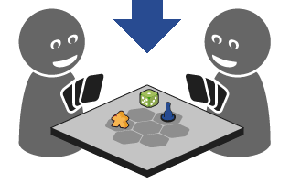
Bounded Suboptimal N-Player Game Tree Search
Advisor: Dor Atzmon
Asi Zaks, Shachar Meretz, Peleg Biton, Omer Nagar
Field : Artificial intelligence (Advisor approved)

Slide 2

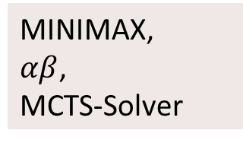
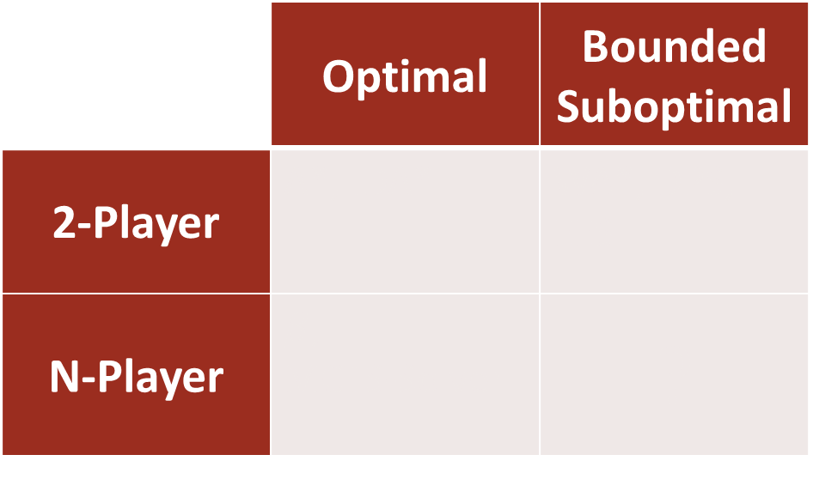
Intro
 | Optimal | Bounded Suboptimal
2-Player | A*, IDA* | WA*, DPS, EES
N-Player | $β$, MCTS-Solver | ?
MINIMAX,
$αβ$,
MCTS-Solver
Bounded $αβ$
MaxN,
Paranoid,
BRS
?

Slide 3

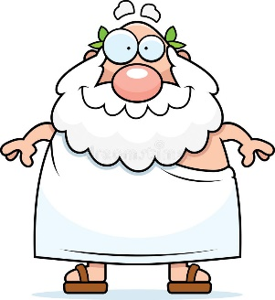
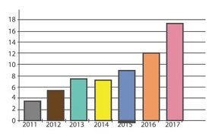
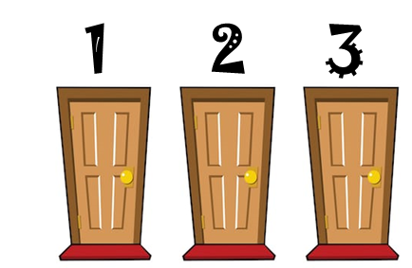



Motivation
Game Theory
Philosophy
Statistics
Decision Theory
Economics
Robotics
Security

Slide 4
Previous Work
Defined optimal solutions for 2-Player & N-Player games.
Shown how and in which conditions optimal solutions for 2-Player & N-Player games can be achieved.
Shown how and in which conditions bounded suboptimal solutions for 2-Player games can be achieved.
Our Goal:
Show how and in which conditions
bounded suboptimal solutions for N-Player games
can be achieved.

Slide 5

Risks & Challenges
Find out that such solution does not exists.
Difficulty to prove that the conditions we defined are sufficient for a legal solution.
Difficulty to show our sub-optimal algorithms correctness.

Slide 6
Main insights from Literary review
Learning about variety of optimal search algorithms solving the same problems, that we might be able to implement a bounded sub-optimal version of or use for comparison with our new solution.
Pattern for defining and proofing conditions for bounded sub-optimal pruning.
Metrics for algorithm evaluation and comparison with known optimal solutions, and how they are computed (ER, AW).
-

Slide 7
The project will include
Conditions for bounded sub-optimal pruning.
A bounded suboptimal N-Player game algorithm, including proof of correctness.
Implementation of 2 game domains.
Result comparison with 2 optimal N-Player game algorithms.
Various experiments to test the effectiveness.

Slide 8
Accomplishments
Understanding bounded suboptimal solutions for 2-Player games.
Understanding optimal solutions for N-Player games.
Define sufficient conditions for bounded suboptimal pruning for N-Player game trees.
Develop A bounded suboptimal N-Player game algorithm - in progress.
Prove the conditions for bounded suboptimal pruning - in progress.
Prove algorithm's correctness - bounded suboptimal version for N-Player games– in progress.

Slide 9
Planned Schedule
Task | Due
Prove the conditions for bounded suboptimal prunning | Ongoing Dec-20
Develop & prove 'MaxN' algorithm's bounded suboptimal version | Ongoing Dec-20
Develop & prove other algorithm's bounded suboptimal version | Jan-21
Write hypothesis for future experiments results | Feb-21
Implement the algorithms we developed | Mar-21
Implement several games for experiments purpose | Mar-21
Implement several algorithms for experiments purpose | Mar-21
Test our implementations | Mar-21
Run experiments | Apr-21
Result analysis & conclusions writing | May-21

Slide 10
Thanks!

